Slide 1

Homework
Open a new Excel sheet
Enter the data given and work on list box from developer option
Find the salary of other months too.
Save your projects as “Developer section”

Slide 2
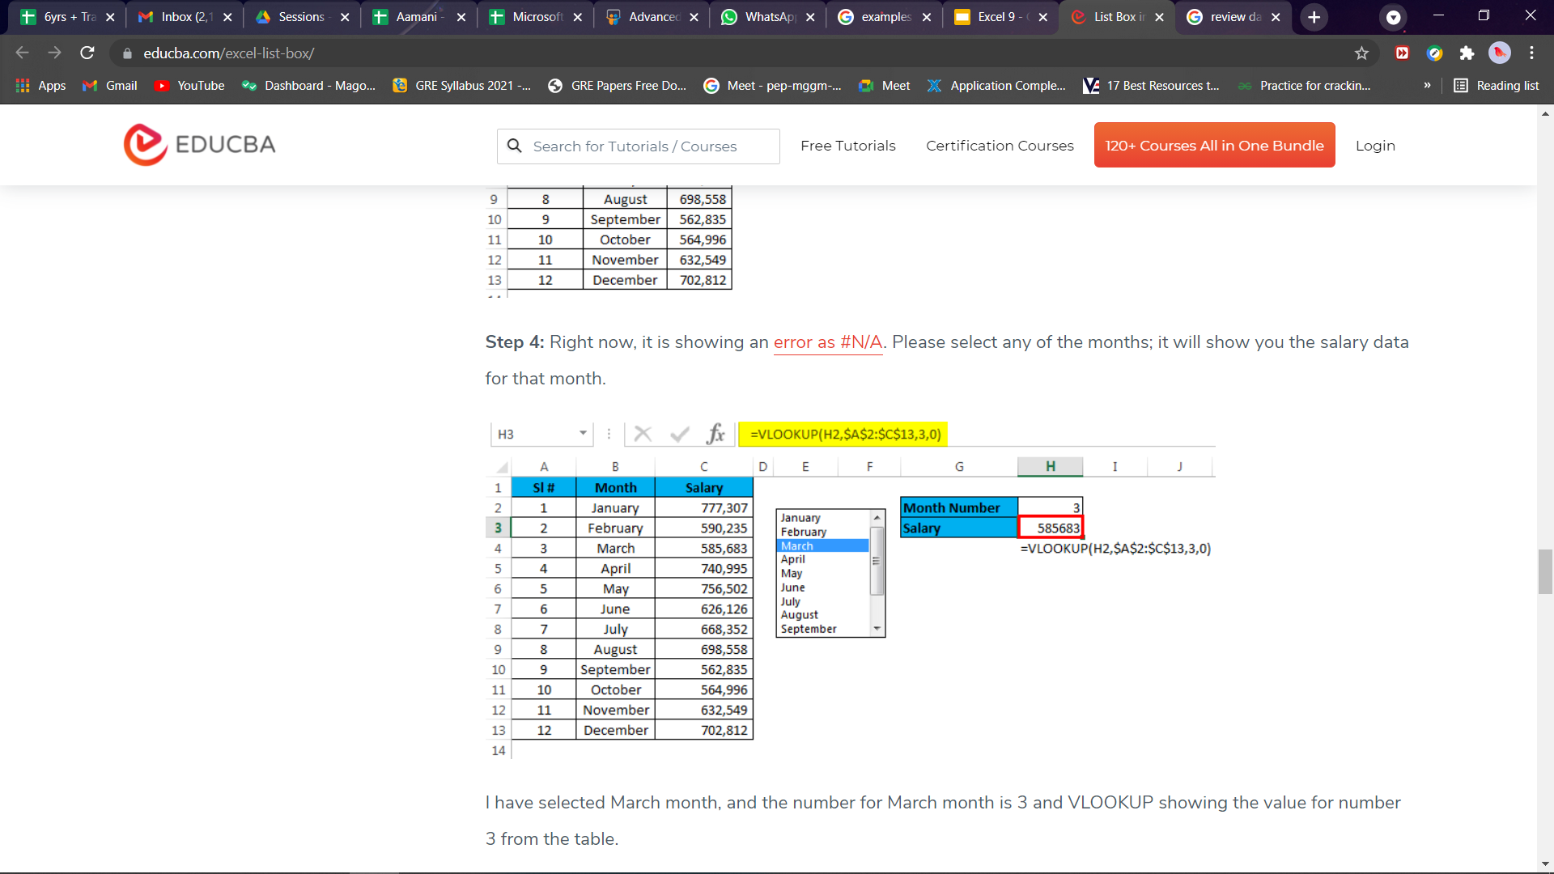
Homework Solution

Slide 3






Excel
Session - 10

Slide 4


Task
Making a TO-DO List
Adding 3 columns for Date, Tasks and status

Slide 5
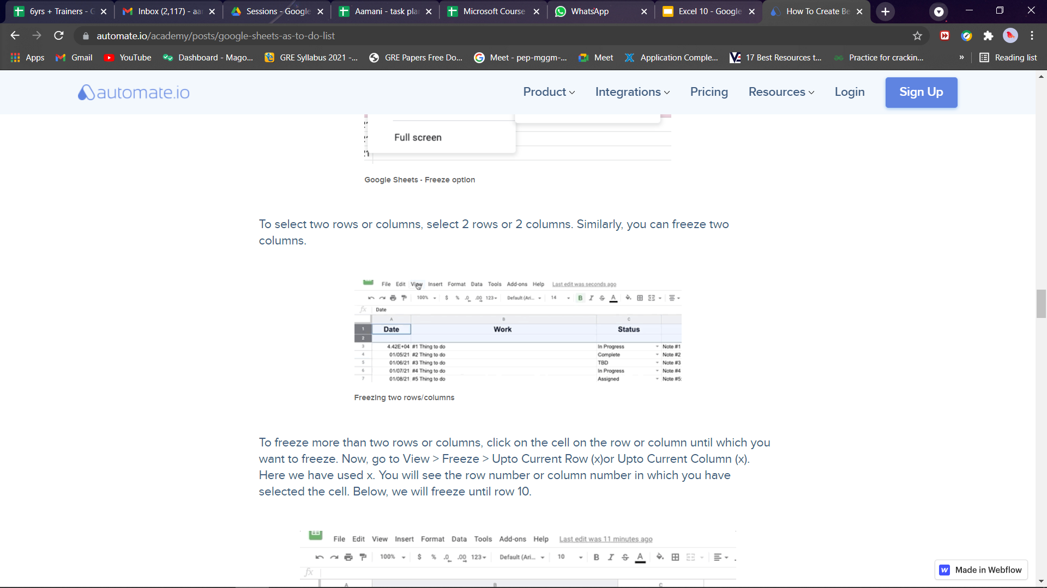
Create Table headings

Slide 6
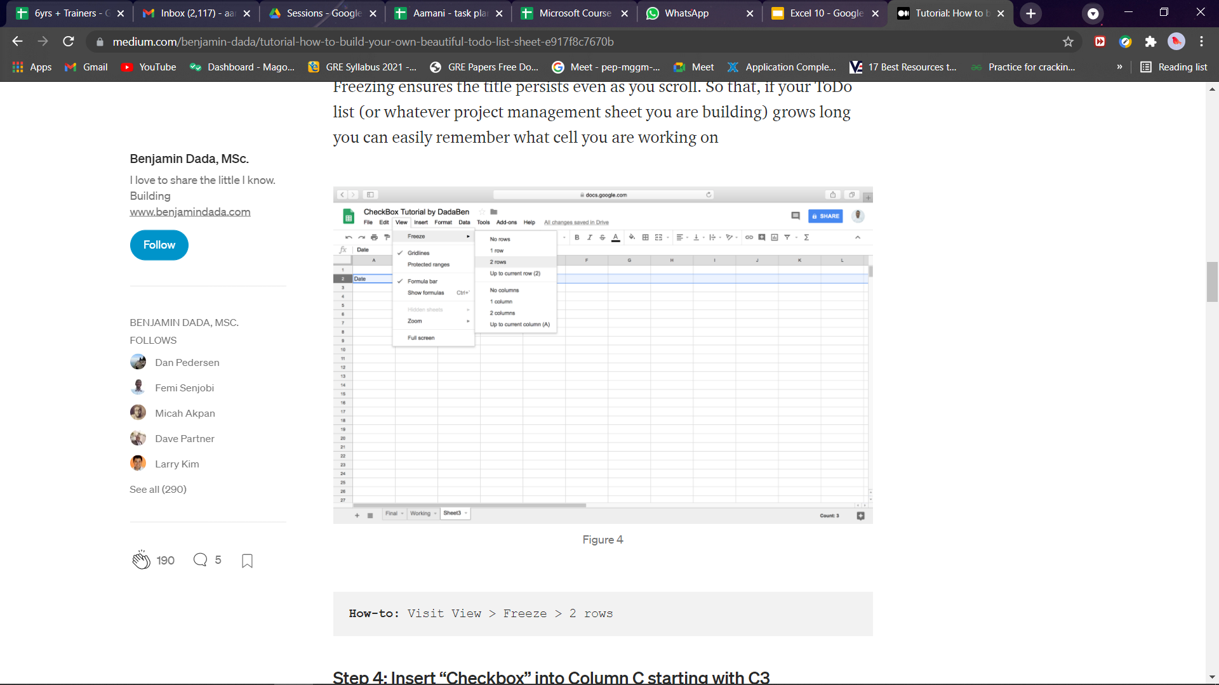
Freeze rows

Slide 7
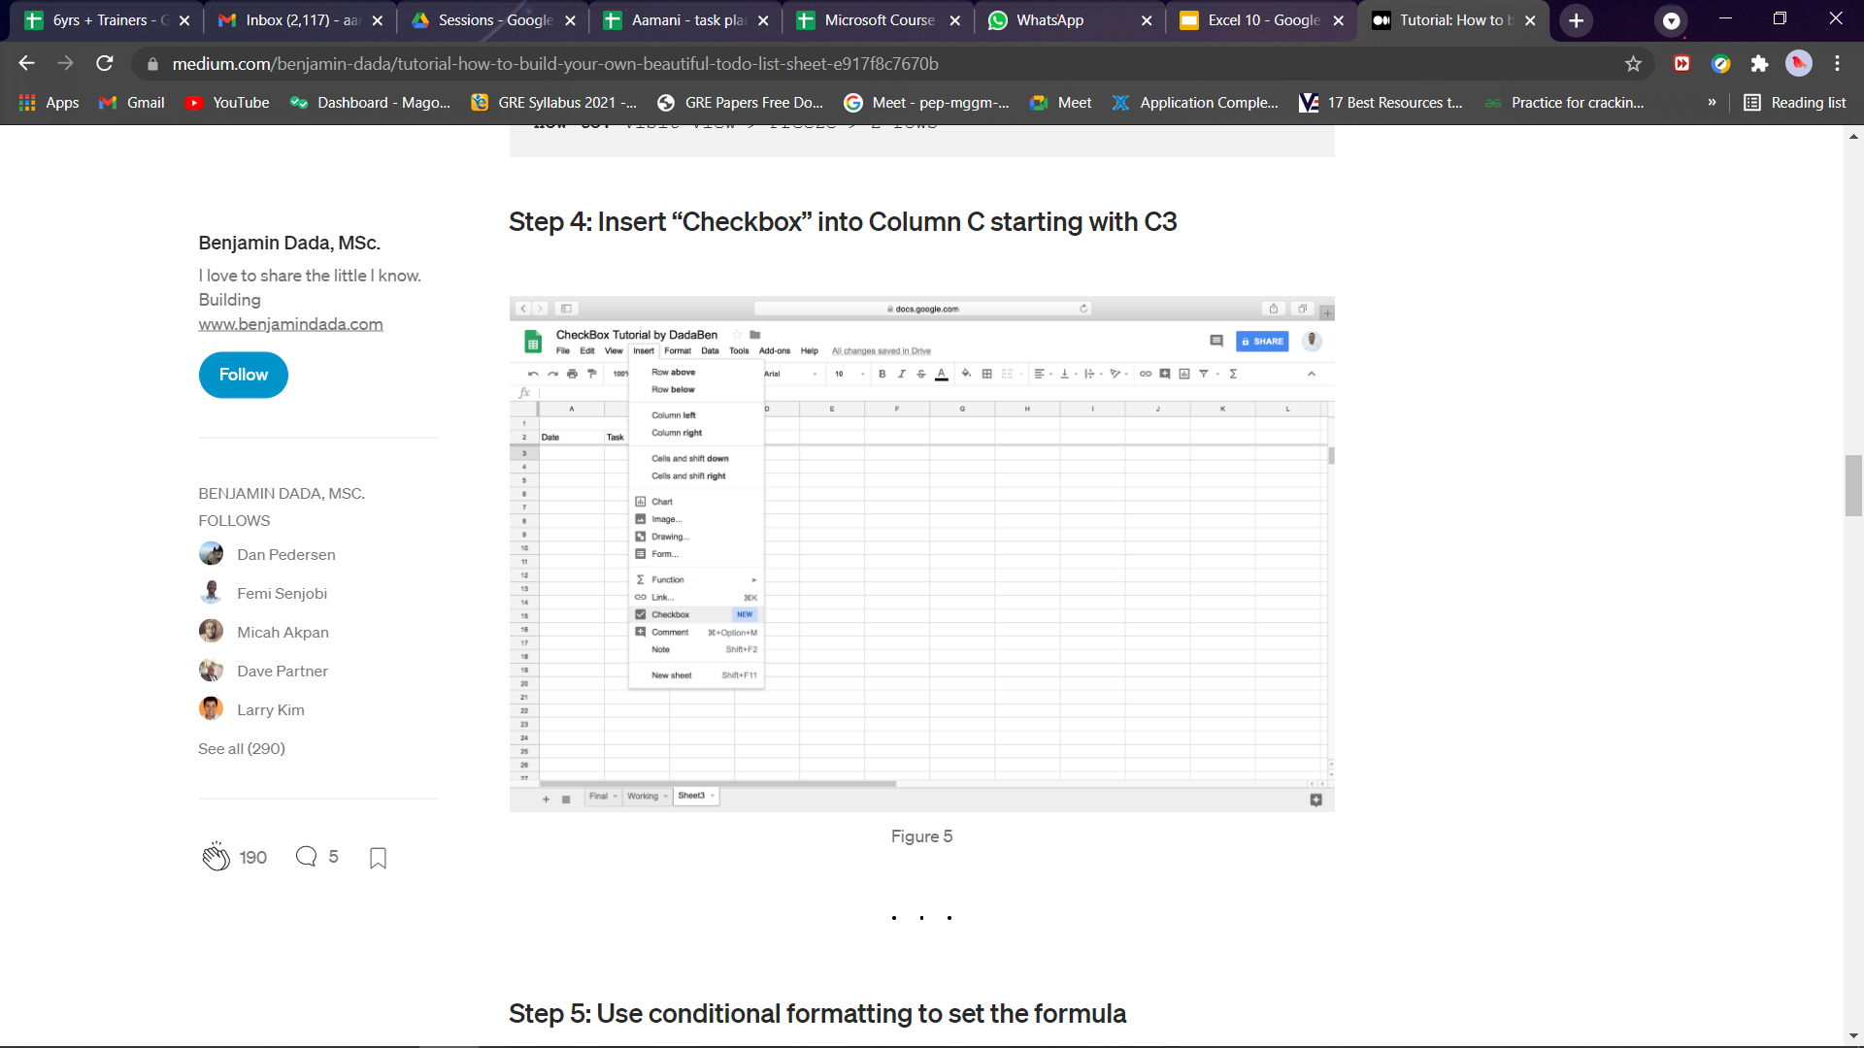

Insert checkbox in column3

Slide 8
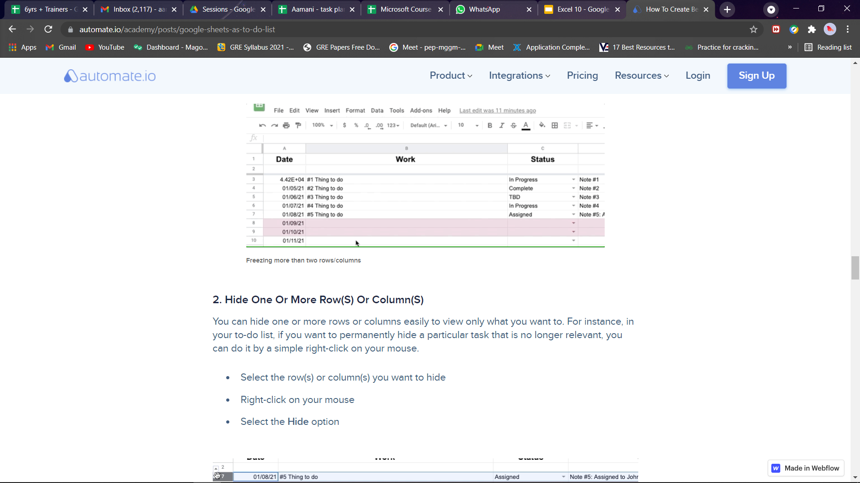
Add tasks in the sheet

Slide 9

MODULE ENDING TEST

Slide 10

ANY QUESTIONS ???

Slide 11



THANK YOU !
contact@littleinventors.in 0091-8368822963 www.littleinventors.in

